Slide 1
Attention, Machine Translation
Natural Language Processing
(based on revision of Chris Manning Lectures)

Slide 2
Announcement
TA announcements (if any)...

Slide 3
Suggested Readings
https://web.stanford.edu/~jurafsky/slp3/10.pdf (machine translation)
Statistical Machine Translation (book by Philipp Koehn)
Sequence to Sequence Learning with Neural Networks (original seq2seq NMT paper)
Sequence Transduction with Recurrent Neural Networks (early seq2seq speech recognition paper)
Neural Machine Translation by Jointly Learning to Align and Translate (original seq2seq+attention paper)
BLEU: a Method for Automatic Evaluation of Machine Translation (how to evaluate MT)
Attention and Augmented Recurrent Neural Networks (blog post overview)
Massive Exploration of Neural Machine Translation Architectures (practical advice for hyperparameter choices)
Achieving Open Vocabulary Neural Machine Translation with Hybrid Word-Character Models (combining character embedding to help out-of-vocabulary problems)
Revisiting Character-Based Neural Machine Translation with Capacity and Compression (another early paper showing character embedding seems to outperform word-based embeddings

Slide 4
Pre-Neural Machine Translation

Slide 5
Machine Translation
Machine Translation (MT) is the task of translating a sentence x from one language (the source language) to a sentence y in another language (the target language).
x: deep learning macht Spaß (German)
y: deep learning is fun (English)

Slide 6
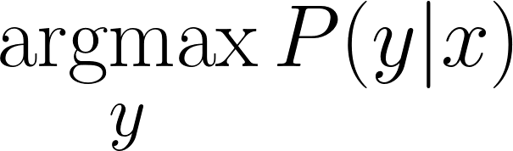
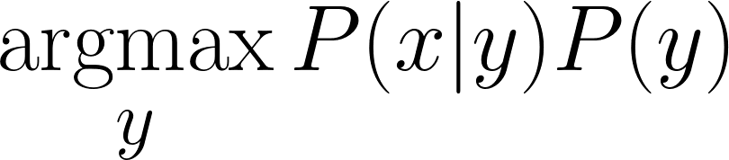
1990s - 2010s: Statistical Machine Translation
Learn a probabilistic model from data :
Uses Bayes Rule to break this down into two components to be learned:
Translation Model: Models how to translate to x given y (fidelity). Learnt from parallel corpus (i.e., German + English).
English Language Model: Models how to write good English (fluency). Learnt from monolingual data.

Slide 7
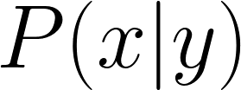

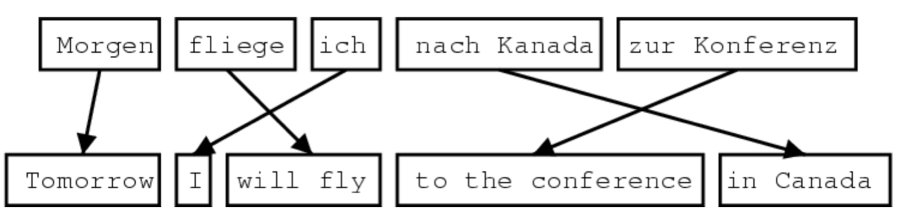
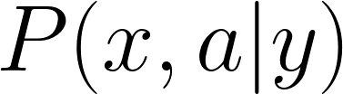
1990s - 2010s: Statistical Machine Translation
How to learn ?
First, need large amount of parallel data (i.e., French and English)
Define alignment , i.e., a word-level correspondence between source sentence x and target sentence y
Redefine the probability which includes the alignment

Slide 8
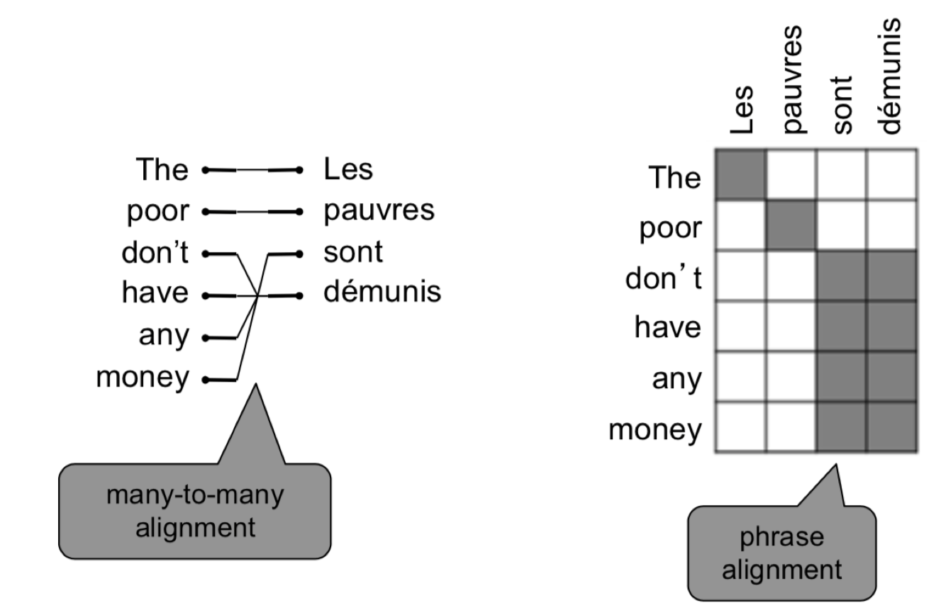
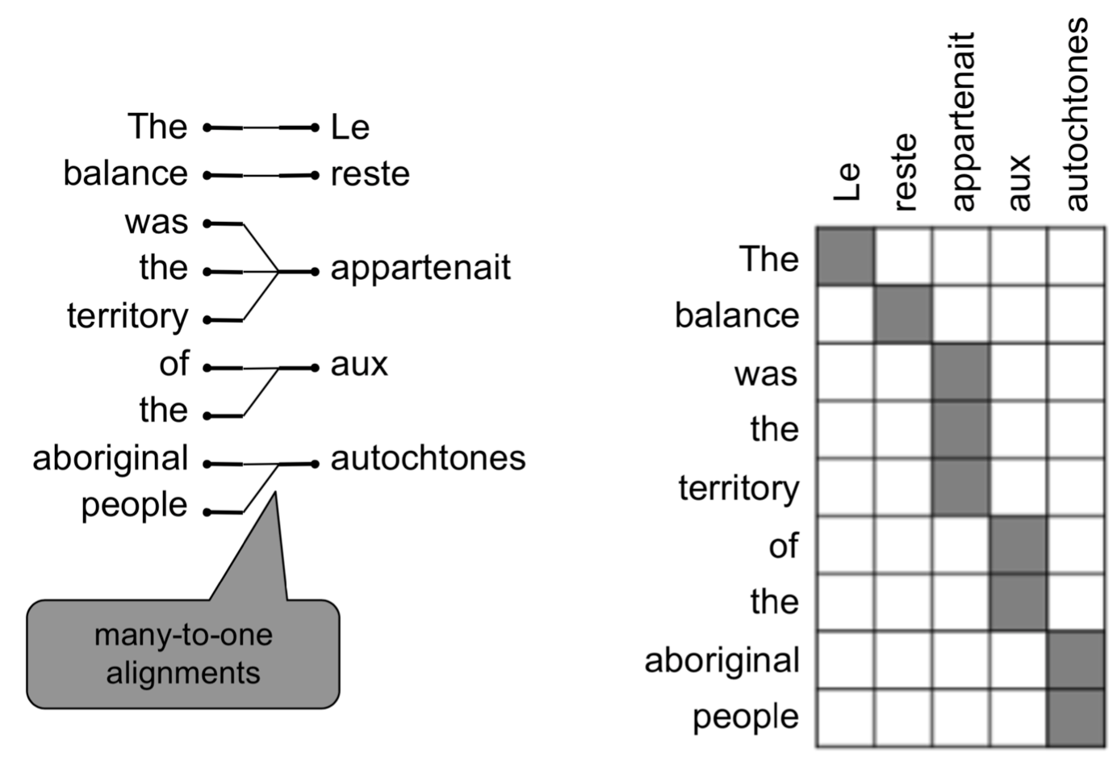
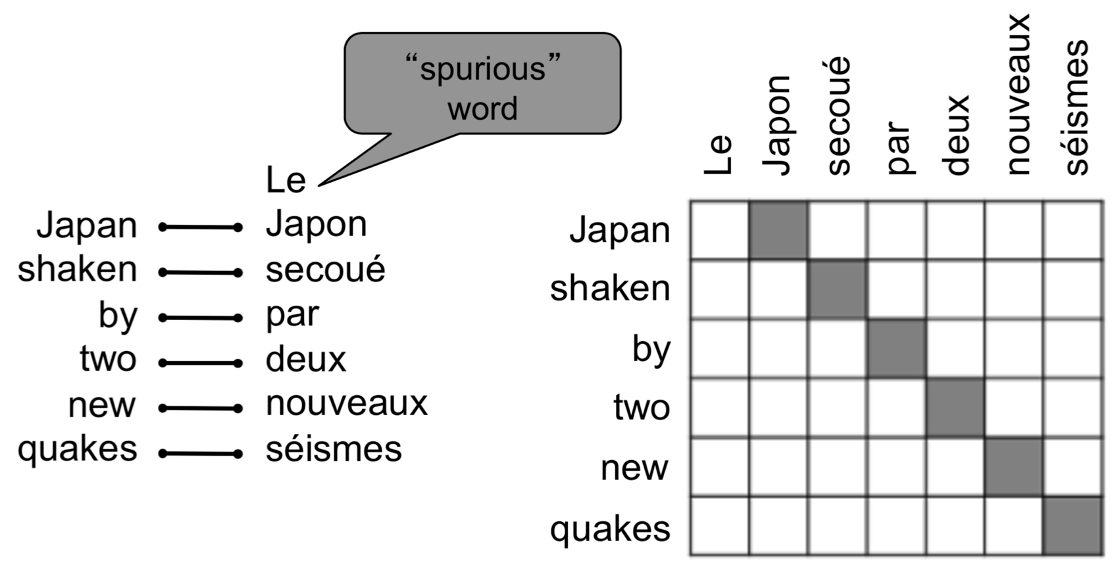
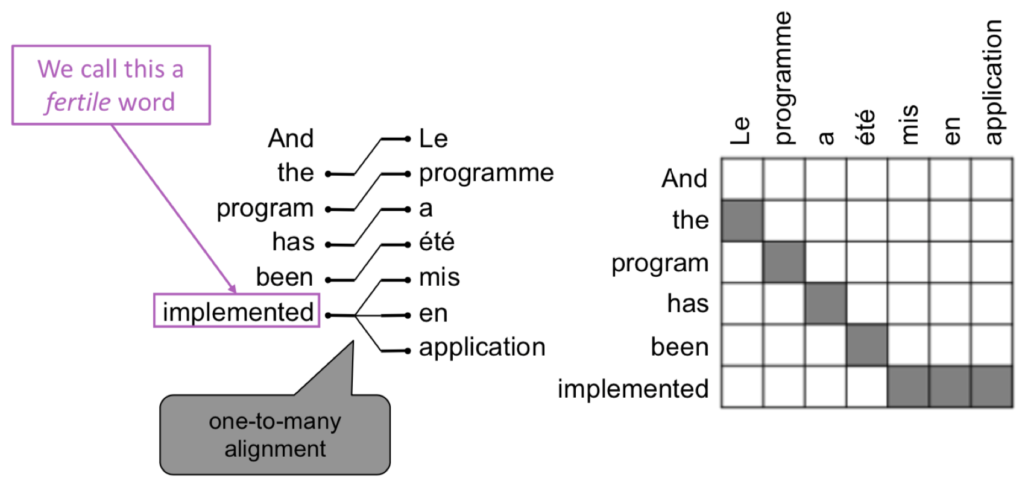
What is alignment?
many-to-many
Alignment is the correspondence between particular words in the translated sentence pair
Note: some words have no counterpart, some have many-to-one relationships,
No counterparts
many-to-one
one-to-many
Examples from: “The Mathematics of Statistical Machine Translation: Parameter Estimation", Brown et al, 1993. http://www.aclweb.org/anthology/J93-2003

Slide 9
Learning alignment
We learn as a combination of many factors:
Probability of particular words aligning
Probability of particular words on a position
Probability of particular words having a particular fertility
Etc.
Alignments are discrete, not probabilistic
Require the use of special learning algorithms (like Expectation-Maximization such as in k-means algorithm) for learning the parameters of distributions

Slide 10
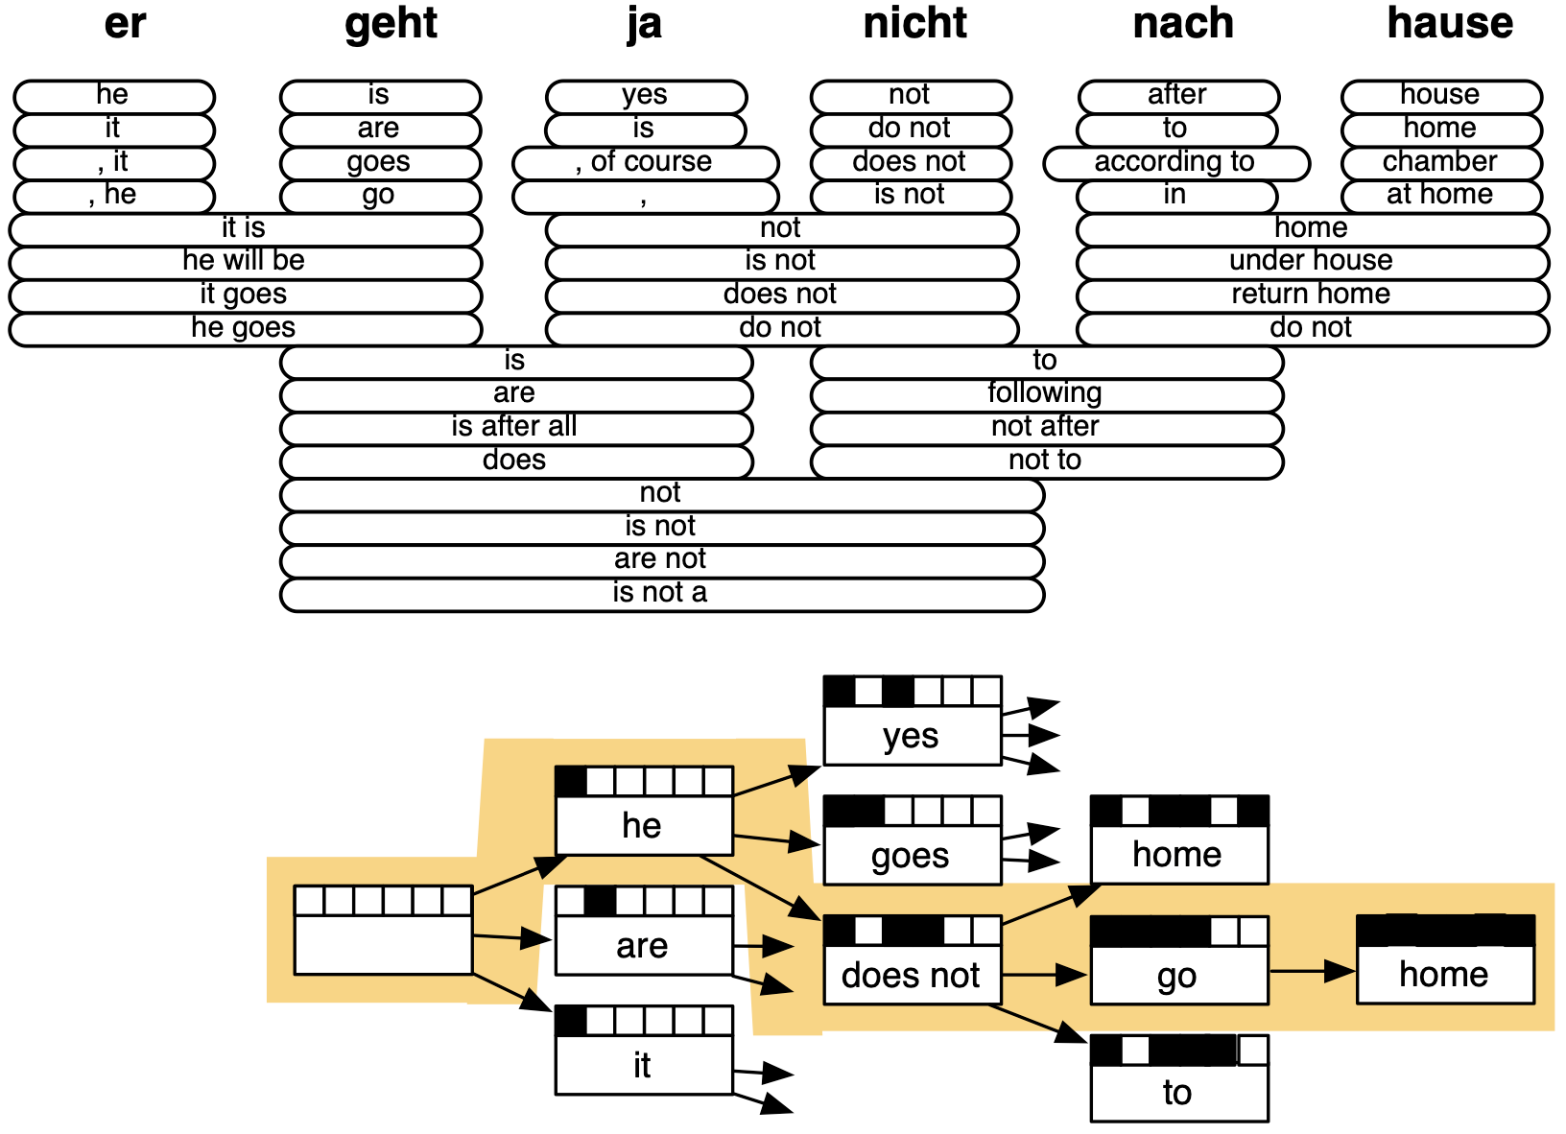
Decoding for SMT
We could enumerate every possible y and calculate the probability -> Too expensive!
Answer: Use some dynamic programming (e.g., viterbi) to figure out optimal paths (this is actually very slow!)
Statistical Machine Translation, Chapter 6, Koehn, 2009. https://www.cambridge.org/core/books/statistical-machine-translation/94EADF9F680558E13BE759997553CDE5

Slide 11
1990s-2010s: SMT
SMT was a huge research field
The best systems were extremely complex
Hundreds of important details we haven’t mentioned here
Systems had many separately-designed subcomponents
Lots of feature engineering
Need to design features to capture particular language phenomena
Require compiling and maintaining extra resources
Like tables of equivalent phrases
Lots of human effort to maintain
Repeated effort for each language pair

Slide 12
Neural Machine Translation

Slide 13
Neural Machine Translation
Neural Machine Translation (NMT) is a way to do Machine Translation with a single end-to-end neural network
The neural network architecture is called a sequence-to-sequence model (aka seq2seq) and it involves two RNNs

Slide 14
Sequence to Sequence Model
Note that this diagram is showing the generation (testing) mode. The training mode will be in “teacher forcing” mode instead.
Encoding of the whole source sentence. Input the final hidden state for Decoder RNN. (Using the final hidden state is not the only way though….we will discuss more later)
deep
learning
is
fun
<END>
argmax
argmax
argmax
argmax
argmax
Encoder RNN
Decoder RNN
deep
learning
macht
Spaß
<START>
deep
learning
is
fun
Encoder RNN produces an encoding of the source sentence.
Decoder RNN is a LM that generates target sentence, conditioned on ending. It does NOT need to be same length as the encoder. It takes in the <START> token, and will stop when it meets the <END> token or the specified max length.

Slide 15
Sequence-to-sequence is versatile
Sequence-to-sequence is useful for more than just MT
Many NLP tasks can be phrased as seq2seq
Summarization ( long text -> short text )
Dialogue ( previous utterances -> next utterances )
Parsing ( input text -> output parse as sequence )
Code generation ( natural language -> Python code )

Slide 16
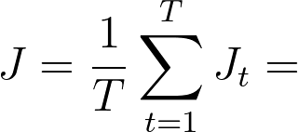
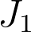
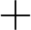
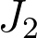
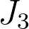
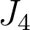
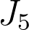
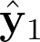
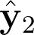
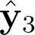
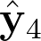
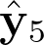
Training a NMT system
“Teacher forcing”
=negative log prob of “deep”
=negative log prob of “fun”
=negative log prob of “<END>”
What is cool is that Seq2seq is optimized as a single system. Backprop operates “end-to-end”. We call this an “end-to-end architecture”.
Encoder RNN
Decoder RNN
deep
learning
macht
Spaß
<START>
deep
learning
is
fun
source sentence (from corpus)
target sentence (from corpus)

Slide 17
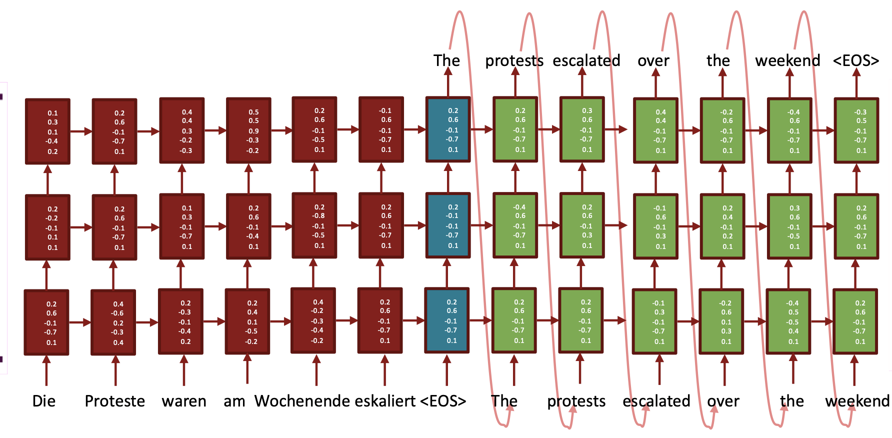
Multilayer (Stacked) NMT
Sequence to Sequence Learning with Neural Networks, Sutskever et al. 2014, https://arxiv.org/abs/1409.3215

Slide 18
Greedy decoding
On our earlier slide, our decoding is of greedy, taking the highest probability word (i.e., argmax). Any potential problem with that?
deep
learning
is
fun
<END>
argmax
argmax
argmax
argmax
argmax
Decoder RNN
<START>
deep
learning
is
fun

Slide 19
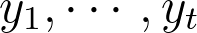
Beam search
Beam search: on each step of decoding, keep track of the k most probable partial translations (which we call hypothesis)
k is the beam size (in practice around 5 to 10)
A hypothesis has a score which is its log prob
Scores are all negative, and higher score is better
We search for high-scoring hypotheses, tracking top k performers
Beam search is not guaranteed to find optimal solution
But much more efficient than exhaustive search!

Slide 20
Beam search - Example
(only for demo purposes - no real data, no real dot product)
Note that k is not the same as n. k refers to the number of parallel search, while n is a stopping criterion when the number of n hypotheses is reached
Beam size = k = 2 (numbers of parallel search). Blue numbers = no.of required hypo = n = 3. Pink refers to the search words
-3.9
Stop searching since you now got 3 hypotheses. You can pick the best one which is “deep learning is fun”, or you can let the user choose.
hard
-4.5
-2.5
-1.7 = log P_{LM} (learning | <START> deep) + -0.7
is
<END>
-1.7
-4.6
-0.7 = log P_{LM} (deep | <START>)
fun
<END>
-0.7
learning
and
-4.1
deep
algorithms
-3.4
scar
blue
-2.8
-5.5
thread
-2.9
gift
-4.9
-2.9 = log P_{LM} (learning | <START> blue) + -0.7
<START>
-2.9
-3.6
-6.1
-1.6 = log P_{LM} (was | <START> he) + -0.9
-5.9
-1.6
gone
-3.6
a
-6.9
of
was
in
and
he
born
pain
,
-0.9 = log P_{LM} (he | <START>)
eat
with
<END>
-0.9
-2.2
-5.3
-6.5
-1.8
-1.8 = log P_{LM} (eat | <START> he) + -0.9
-2.5
-6.1

Slide 21
Beam search - stopping criterion
In greedy decoding, usually we decode until the model produces an <END> token For example: <START>deep learning is fun<END>
In beam search decoding, different hypotheses may produce <END> tokens on different timesteps
When a hypothesis produces <END>,that hypothesis is complete.
Place it aside and continue exploring other hypotheses via beam search
Usually we continue beam search until:
We reach time step T (where T is some predefined cutoff),or
we have at least n completed hypotheses (where n is pre-defined cutoff)
Potential problem: longer sentences tend to have lower scores
Fix: normalize by length (divide by length)

Slide 22
NMT vs. SMT
NMT Pros:
Better performance
More fluent
Better use of context
Better use of phrase similarities
A single network that does all
Less human engineering effort
NMT Cons:
Less interpretable
Hard to debug
Difficult to control
Difficult to impose policy or rules

Slide 23
NMT: perhaps the biggest success of NLP?
NMT went from fringe research attempt in 2014 to the leading standard method in 2016
2014: First seq2seq paper published
2016: Google Translate switches from SMT to NMT and by 2018 everyone switches (Microsoft, Tencent, Baidu, Facebook, etc.)
It is kind of sad that SMT systems were built by hundreds of engineers over many years, but were outperformed by NMT trained by small number of engineers in a few months :(

Slide 24
Is NMT solved?
Many difficulties remain:
Out-of-vocabulary
Domain mismatch between train and test data
Maintaining context over longer text
Lower-resource language pairs
Failures to accurately capture sentence meaning
Pronoun (or zero pronoun) resolution errors
Morphological agreement errors
“Has AI surpassed humans at translation? Not even close!” https://www.skynettoday.com/editorials/state_of_nmt

Slide 25
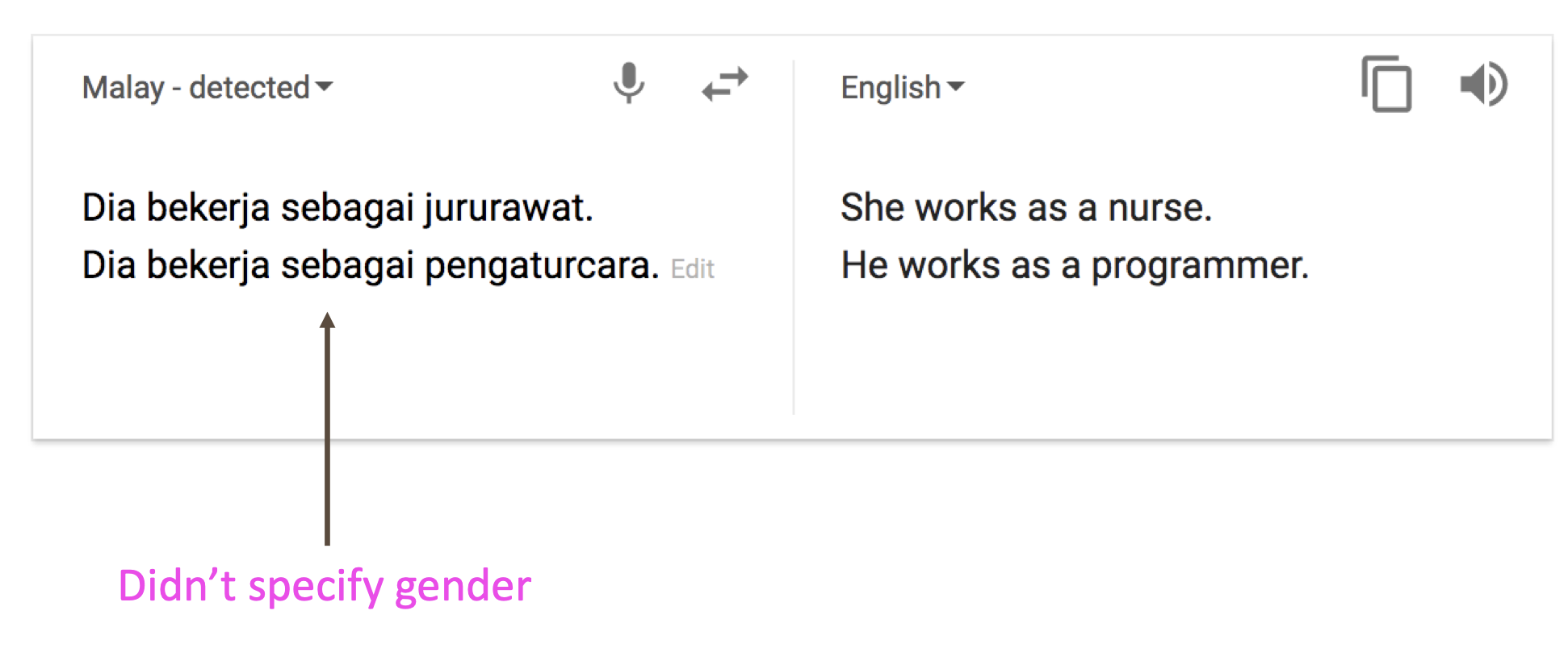
Is NMT solved?
Gender bias still exists (corpus bias)
https://hackernoon.com/bias-sexist-or-this-is-the-way-it-should-be-ce1f7c8c683c

Slide 26
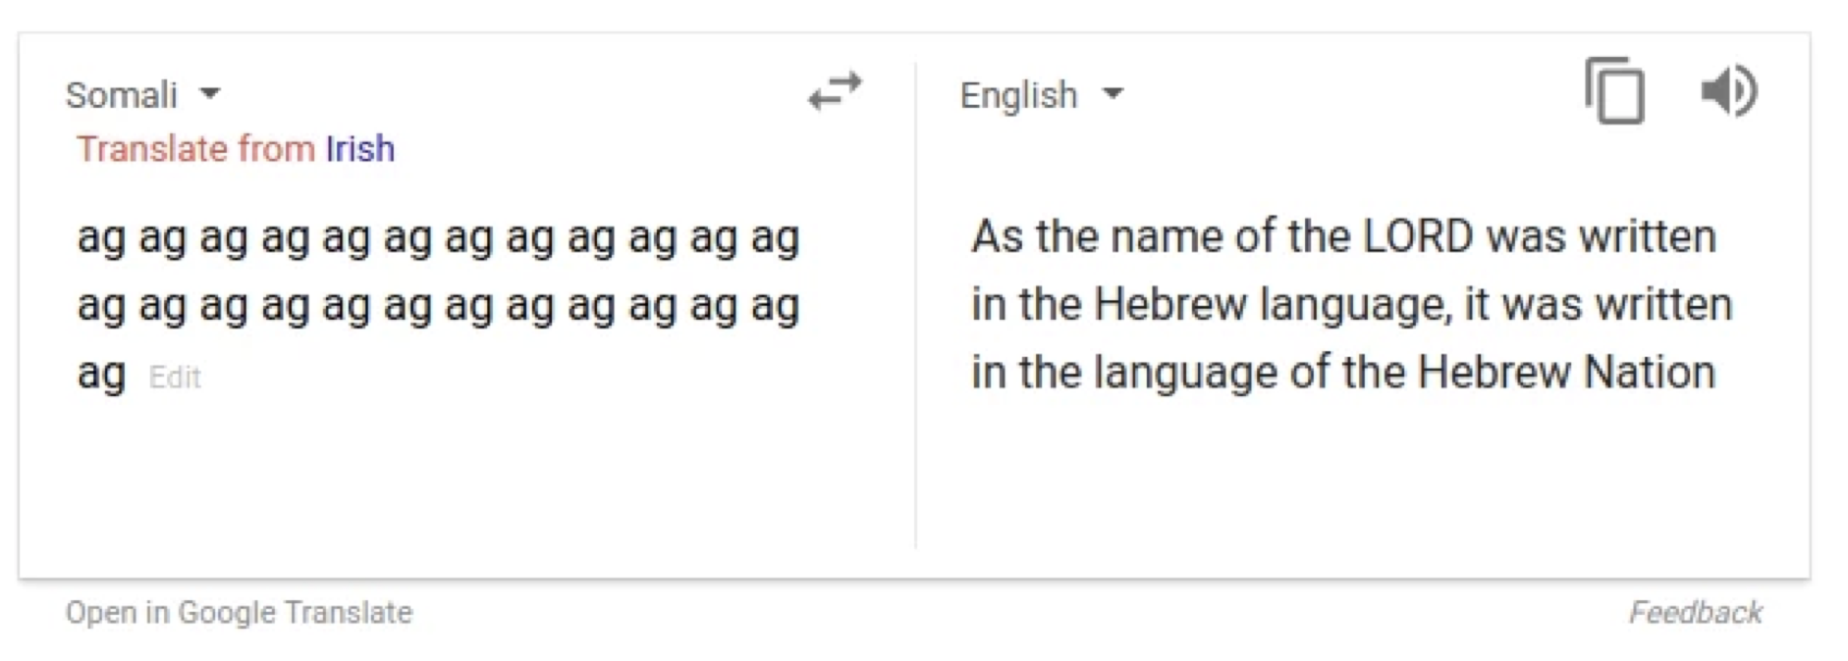
Is NMT solved?
Sometimes strange stuff happens (low resource language)
https://www.skynettoday.com/briefs/google-nmt-prophecies

Slide 27
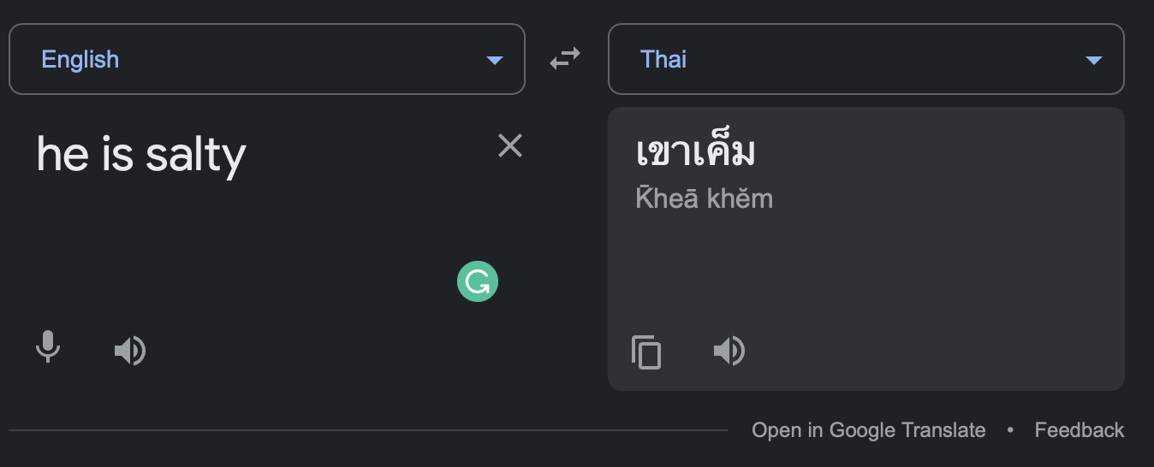
Is NMT solved?
Humor is difficult!

Slide 28
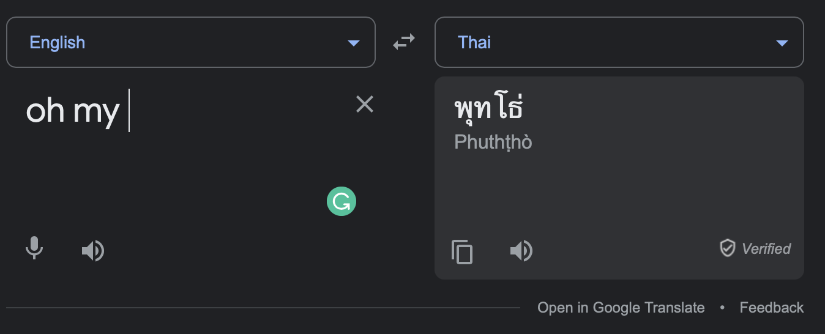
Is NMT solved?
Probably translated again from (“oh my god”)

Slide 29
NMT Evaluation

Slide 30
How do we evaluate MT?
BLEU (Bilingual Evaluation Study)
BLEU compares the machine-written translation to one or several human-written translation(s), and computes a similarity score based on:
n-gram precision (usually for 1, 2, 3 and 4-grams)
Plus a penalty for too-short system translations
BLEU is useful but imperfect
There are MANY valid ways to translate a sentence
So a good translation can get a poor BLEU score because it has low n-gram overlap with the human translation
BLEU: a Method for Automatic Evaluation of Machine Translation, Papineni et al, 2002. http://aclweb.org/anthology/P02-1040

Slide 31
NMT with Attention

Slide 32
NMT with attention
In 2021: NMT research continues to strive
Researchers have many, many improvements to the “vanilla” seq2seq NMT system we’ve just presented
One huge improvement so integral that it is the new vanilla: Attention

Slide 33
NMT with attention
Using the final hidden state can be risky, as we need to assume that this hidden state captures all information
deep
learning
is
fun
<END>
argmax
argmax
argmax
argmax
argmax
Encoder RNN
Decoder RNN
deep
learning
macht
Spaß
<START>
deep
learning
is
fun

Slide 34
NMT with attention
Idea: use direct connection to focus on a particular part of the source sequence
Attention output
Weighted sum
deep
The weighted sum is like a selective summary of the information
Attention distribution
Concatenate and compute
softmax
softmax
softmax
softmax
Attention score
dot product
Encoder RNN
Decoder RNN
deep
learning
macht
Spaß
<START>

Slide 35
NMT with attention
Idea: use direct connection to focus on a particular part of the source sequence
Attention output
Weighted sum
learning
Attention distribution
softmax
softmax
softmax
softmax
Attention score
Sometimes, we take the attention output from the previous step, and also feed it into the decoder (along with the usual decoder input)
Encoder RNN
Decoder RNN
deep
learning
macht
Spaß
<START>
deep

Slide 36
NMT with attention
Idea: use direct connection to focus on a particular part of the source sequence
Attention output
Weighted sum
<END>
Attention distribution
softmax
softmax
softmax
softmax
Attention score
Encoder RNN
Decoder RNN
deep
learning
macht
Spaß
<START>
deep
learning
is
fun

Slide 37
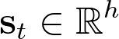
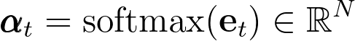
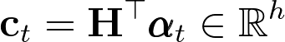
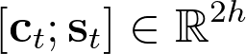
Attention - formally
We have encoder hidden states
On timestep t, we have decoder hidden state
We get the attention scores
We take softmax to get the attention distribution for this step (this is a probability distribution and sums to 1)
We use to take a weighted sum of the encoder hidden states to get the attention (context) output
Finally, we concatenate the attention output with the decoder hidden state and proceed as in the non-attention seq2seq

Slide 38
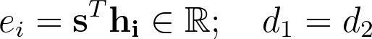
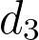
Attention - variants
Most variants differ in how they compute the energy. Assume the followings:
General attention
Multiplicative attention
Additive attention
( is a hyperparameter)
Much more! in Attentive Surveys in Attention Models, Chaudhari et al. 2019, https://arxiv.org/pdf/1904.02874.pdf

Slide 39
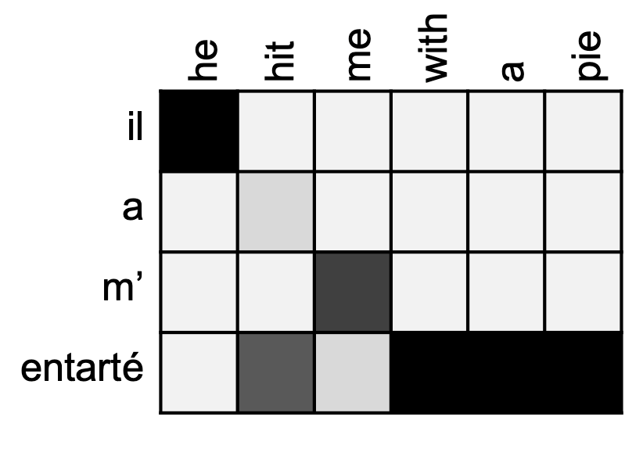
Attention is state-of-the-art
Attention significantly improves NMT performance as well as other NLP tasks (as we shall see in Transformers)
Attention is not only for seq2seq. It’s a general deep learning technique that can be applied almost on any architectures or tasks (e.g., classification tasks, or even CNN!)
Attention helps with vanishing gradient problem
Provides shortcut to faraway state
Attention provides some interpretability
By inspecting attention distribution, we can see what the decoder was focusing on
We get alignment for free!
The is cool, because we never explicitly trained an alignment system

Slide 40
Summary
Seq2seq - powerful for many tasks including NMT, text summarization, dialogue, etc.
Many variants!
Attention is a way to focus on particular parts of the input
Improves seq2seq a lot!
Many variants
Can also apply to classification purpose - imagine you have no decoder

